Slide 1


Analysis of smoking status impact on molecular mechanisms of SARS-CoV-2 viral entry through single-cell sequencing experiments
Author: Mateusz Urbanek
Supervisor: PhD Anna Papież
Notes:
Note: After adding your pictures, right click on it and “Send To Back”.

Slide 2

01
Introduction
What is Single Cell data, and why is it important?
02
Research background and motivation
What is the impact of smoker’s status on SARS-COV-2
03
Workflow methodology
Table of contents
How did I approach analysis of Single Cell Data
04
Results Discussion
What can be concluded from the analysis?
05
Discussion
Time for question

Slide 3
01
Introduction
What is Single Cell data, and why is it important?
Notes:
Note: After adding your pictures, right click on it and “Send To Back”.

Slide 4
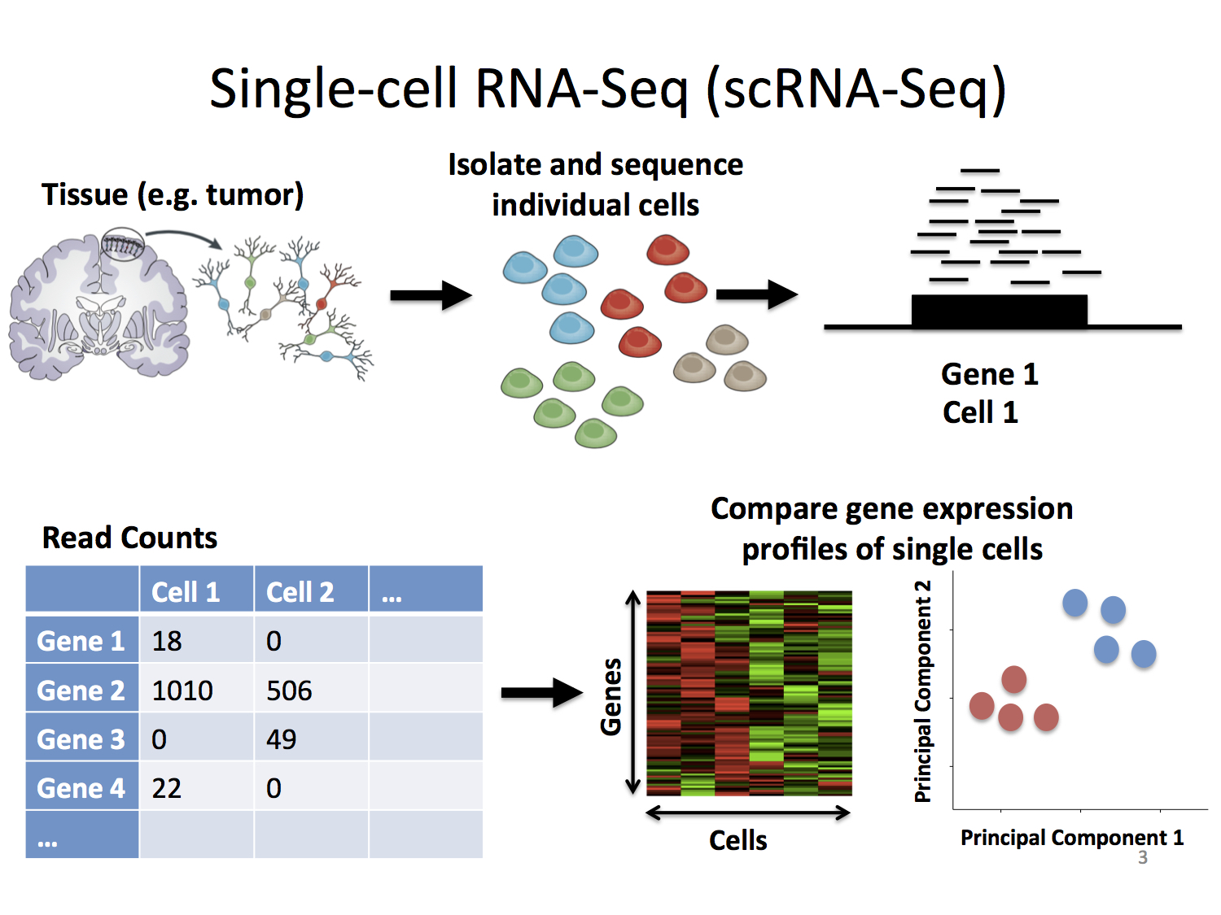
01 - Introduction
Single Cell RNA-seq
RNA sequencing (RNA-seq) - genomic approach for the detection and quantitative analysis of messenger RNA molecules in a biological sample and is useful for studying cellular responses.
Single Cell RNA sequencing (scRNA-seq) - cell are sorted then RNA-seq is performed on specific cell types separately.
Stephanie Hicks Welcome to the World of Single-Cell RNA-Sequencing https://speakerdeck.com/stephaniehicks/welcome-to-the-world-of-single-cell-rna-sequencing?slide=3

Slide 5
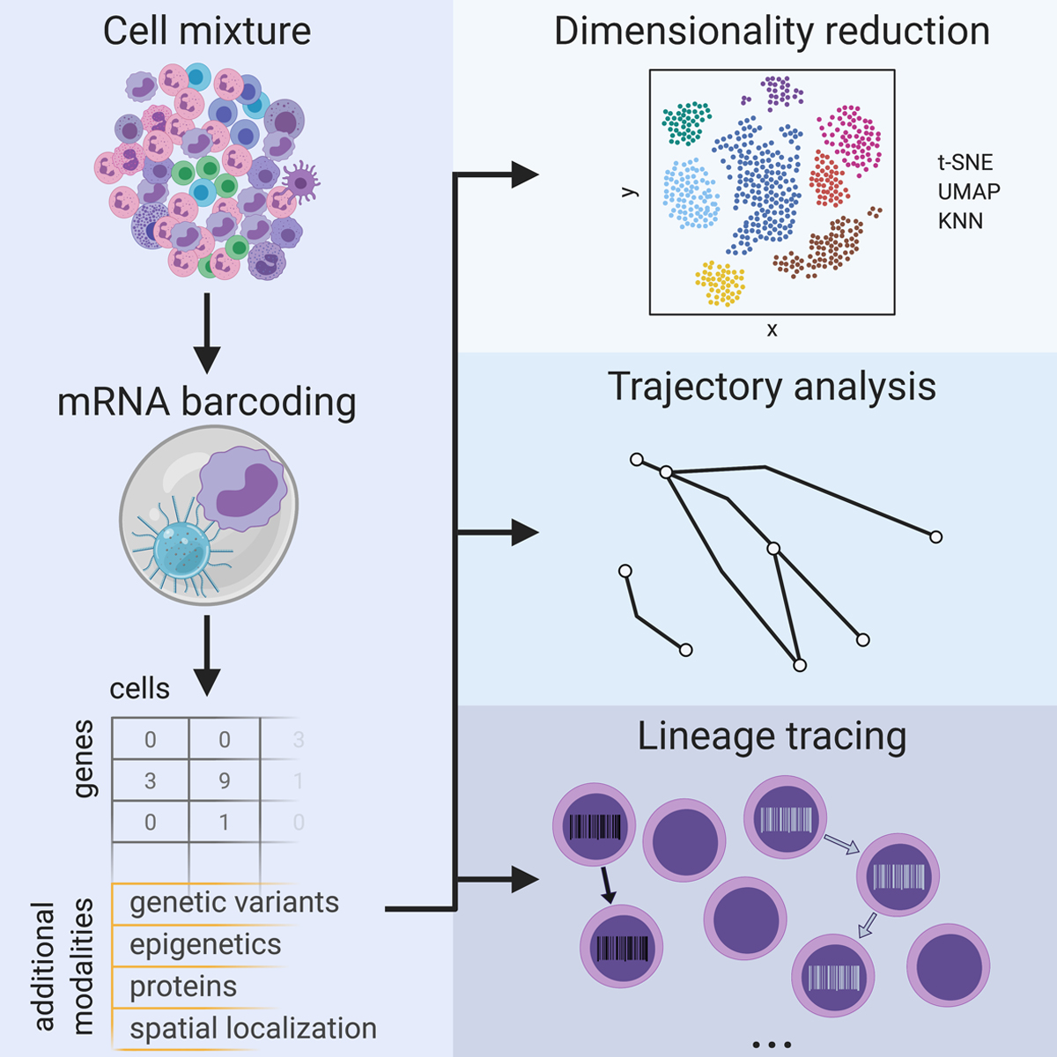
01 - Introduction
Why we need Single Cell RNA-seq?
Single-cell RNA sequencing (scRNA-seq), for example, can reveal complex and rare cell populations, uncover regulatory relationships between genes, and track the trajectories of distinct cell lineages in development.
Jean Acosta, Daniel Ssozi and Peter van Galen
Single-Cell RNA Sequencing to Disentangle the Blood System
https://www.ahajournals.org/doi/10.1161/ATVBAHA.120.314654

Slide 6
02
Research background and motivation
What is the impact of smoker’s status on SARS-COV-2

Slide 7
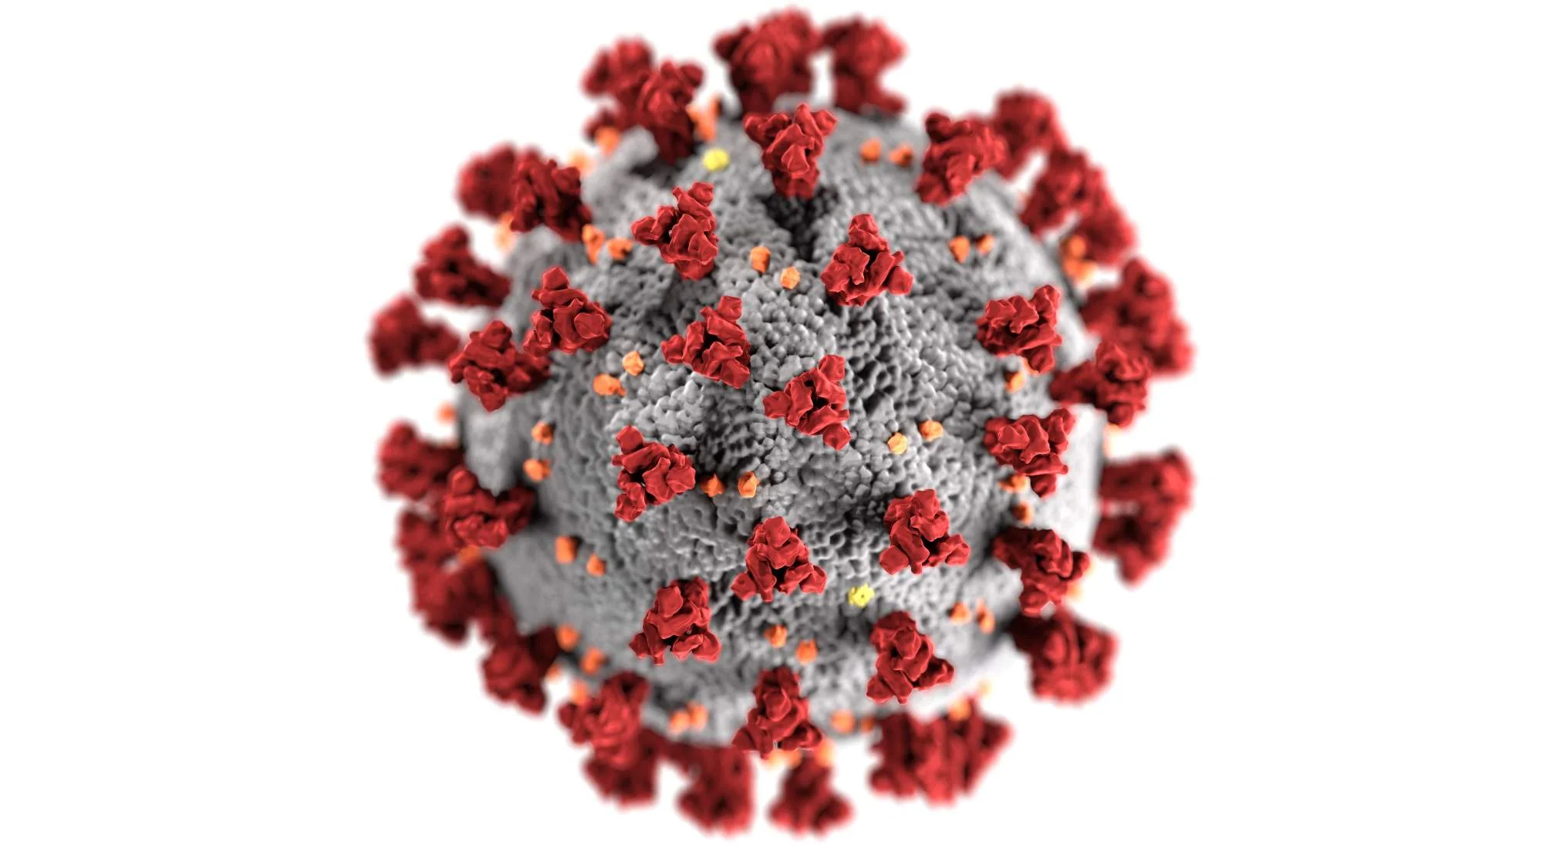
02 - Research background
Why this topic?
COVID-19 is a popular topic nowadays
Huge research potential
There will be more and more data in the future
Personal reasons – family member (smoker) suffered complications after COVID-19

Slide 8
02 - Research background
State of art
Single-cell analysis identifies shared and distinct immune features of COVID-19, Influenza and other community-acquired pneumonia
https://doi.org/10.7554/eLife.69661
Single-Cell Transcriptomic Analysis of Human Lung Reveals Complex Multicellular Changes During Pulmonary Fibrosis II
https://doi.org/10.1164/rccm.201712-2410OC
Integrated analyses of single-cell atlases reveal age, gender, and smoking status associations with cell type-specific expression of mediators of SARS-CoV-2 viral entry and highlights inflammatory programs in putative target cells
https://doi.org/10.1101/2020.04.19.049254

Slide 9
02 - Research background
Data sets
Classic scRNA-seq analysis of the SARS-CoV-2/Pneumonia data
Comparative analysis of the results of scRNA-seq SARS-CoV-2/Pneumonia and partially public data processed in the integrated meta analysis.

Slide 10
03
Workflow
How did I approach analysis of Single Cell Data

Slide 11
03 - WOrkflow
TODO
TODO

Slide 12
04
Results discussion
What can be concluded from the analysis?

Slide 13
04 – RESULTS DISCUSSION
TODO
TODO

Slide 14
05
Discussion
Time for questions

